Slide 1
AAC Project Two

Slide 2

Purpose
With this project we will attempt to answer the following question
“Does living in a non-urban area put you less at risk with regards to Covid-19?”
-How did we define Urban and Non-Urban?

Slide 3

Big Blockers
Some of the blockers we met along the way are
-Software Issues
-Coding Problems
The Magic Solution to our Coding Problems
“Learning Spark Lightning-Fast Data Analytics”

Slide 4
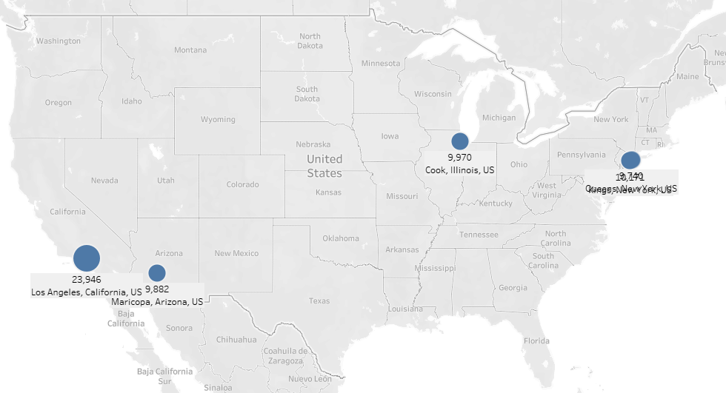
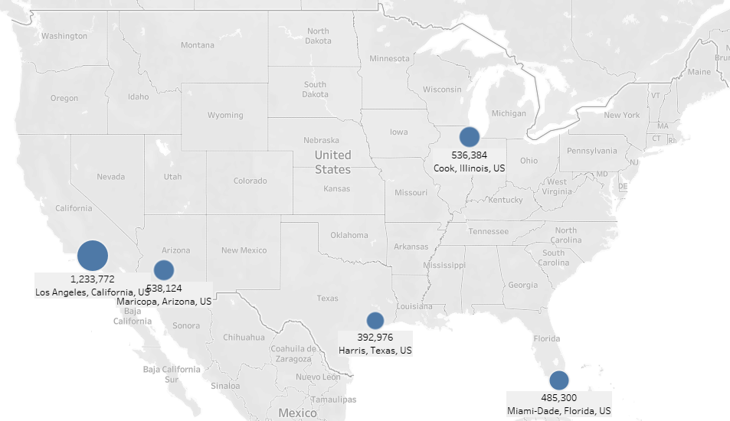
Top 5 Urban Areas Deaths vs Cases

Slide 5
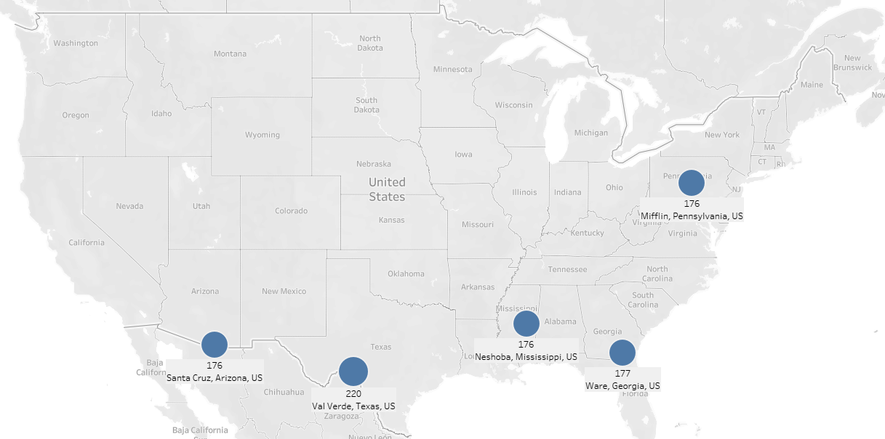
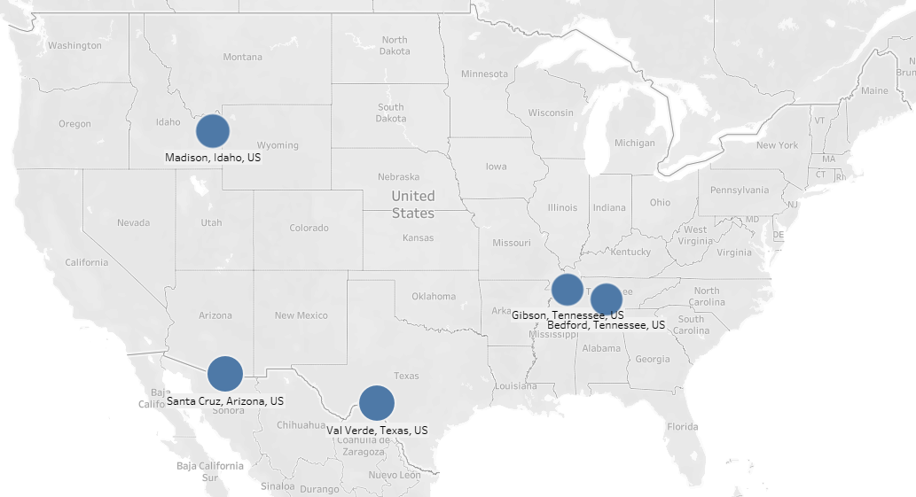
Top 5 Non-Urban Areas Deaths vs Cases

Slide 6

Why we chose to use deaths as the primary data source

Slide 7
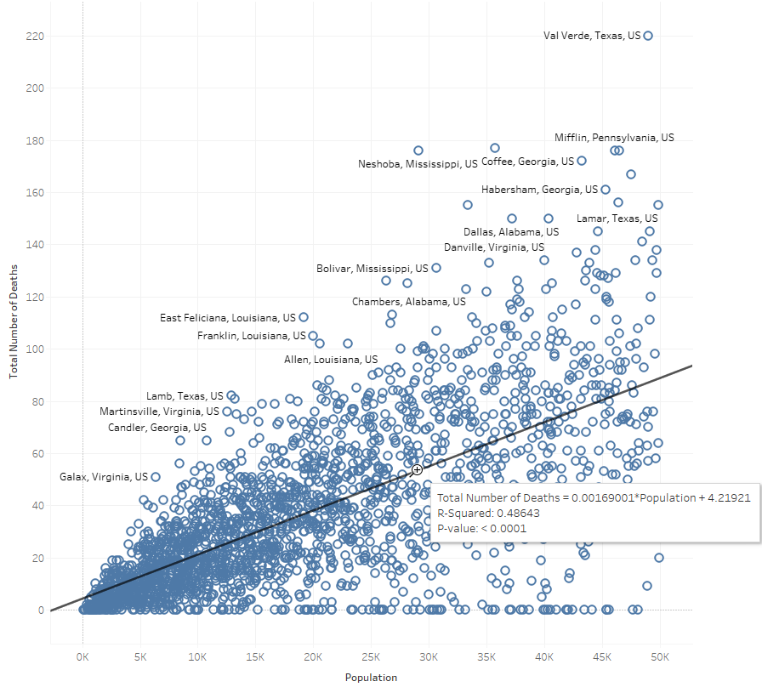
Total Deaths for All Non-Urban Areas
The trend line drawn shows an R-squared value of 0.486
What does this tell us?

Slide 8
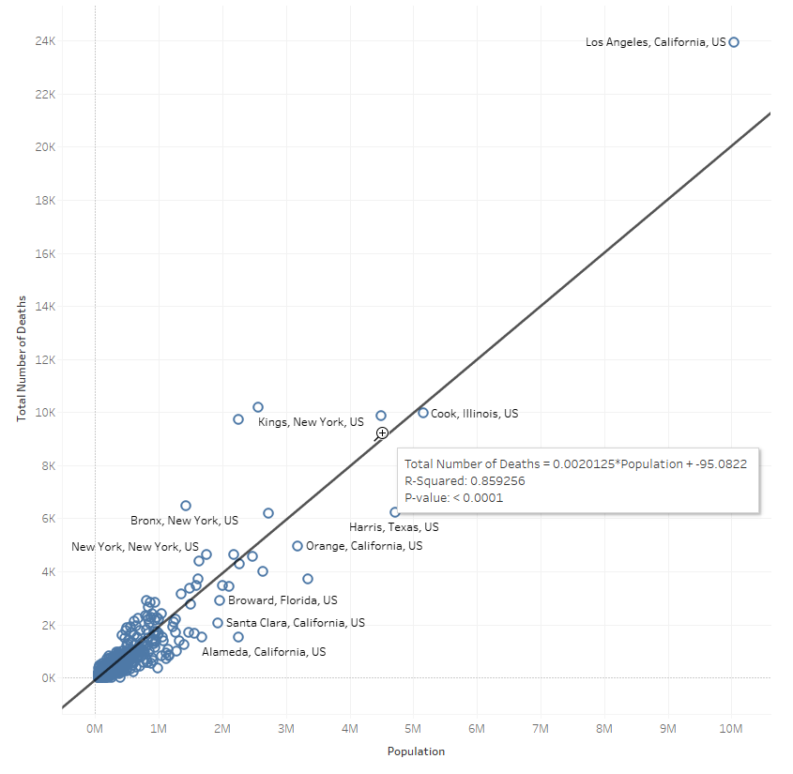
Total Deaths for All Urban Areas
The trend line drawn shows an R-squared value of 0.859
What does this tell us?

Slide 9
Is there a real trend?
The answer is…. It’s complicated.
Why is the trend so much more inaccurate for Non-Urban areas?

Slide 10
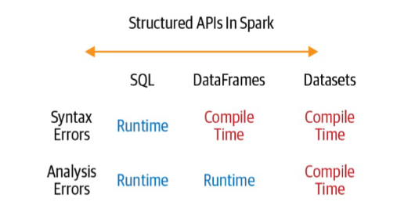
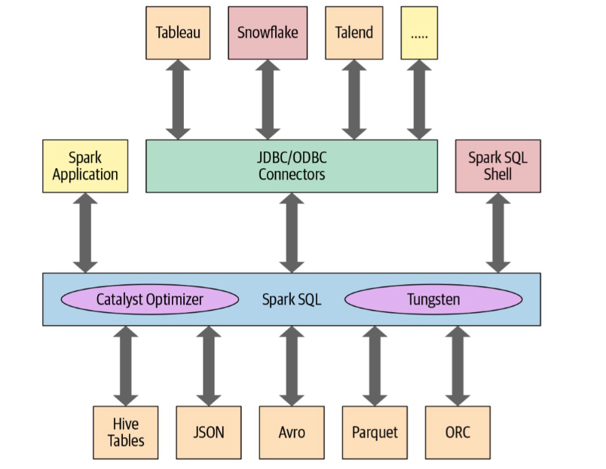
Helping understand how to tackle the problem

